Slide 1

Web scraping to gain company insights
16/07/2023

Slide 2
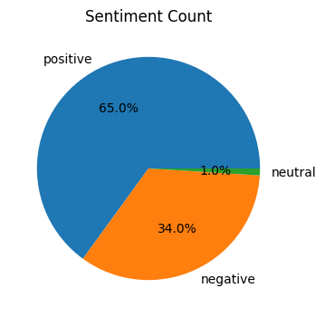
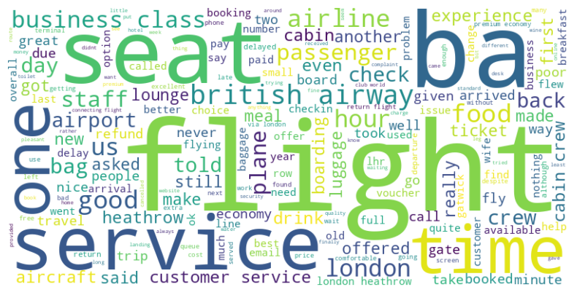
INSIGHTS FROM CUSTOMER REVIEWS
From cleaning 1000 reviews given by the customers, we obtained
Positive Reviews - 650
Negative Reviews - 340
Neutral Reviews – 10
Word cloud of keywords used in reviews:

Slide 3
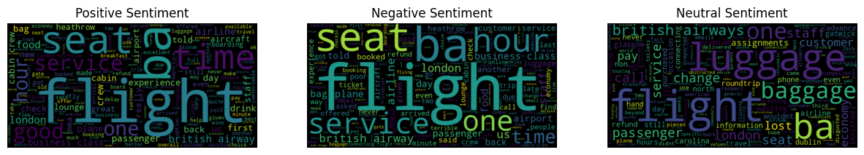
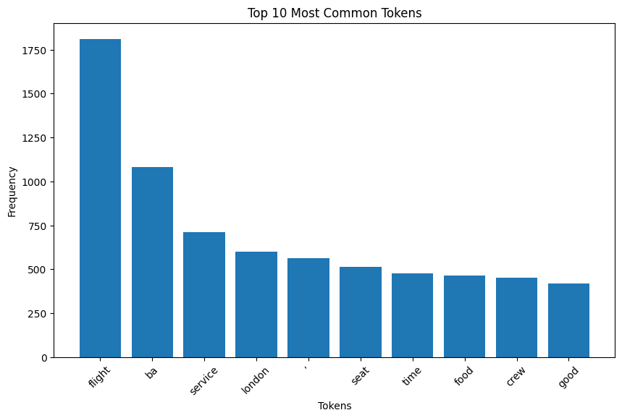
INSIGHTS FROM CUSTOMER REVIEWS
Wordcloud for each sentiment:
This frequency chart shows the most common
keywords within the reviews.

